Slide 1
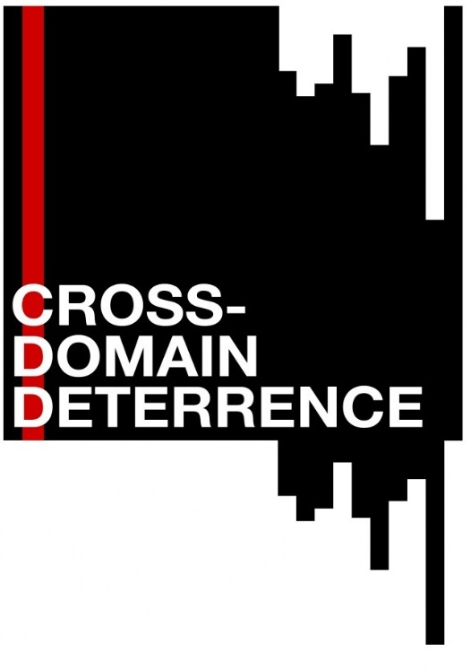








Cross Domain Deterrence in the Gray Zone
Minerva Conference
9 September 2015
Erik Gartzke
Jon Lindsay

Slide 2

Cold War Deterrence
Defense vs. Deterrence
Nuclear weapons
Chicken games
Stability-Instability
Notes:
Deterrence has been an option throughout history, but defense has usually been more attractive
Nuclear weapons made defense prohibitively costly, so deterrence became necessary
Traditional theory focuses on high-stakes crisis bargaining between superpower—games of chicken
In practice, states “design around” nuclear stalemate through low intensity conflict, subversion, proxy wars—stability-instability paradox
Grand strategy was complicated in the era of Dr. Strangelove, but it was at least clear who the players where and that the stakes were enormous. Since military defense against nuclear attack was impossible or too risky, deterrence theory provided the intellectual foundation for an alternative strategy that helped to keep the Cold War cold. In theory, nuclear threats prevented Armageddon. Yet in practice, both sides explored new means to pursue their objectives without triggering war.

Slide 3

Cross Domain Deterrence
Nuclear Forces
Missile Defense
Space
Cyberspace
(Air, Sea, Land,…)
Attribution?
Act of War?
Credibility?
Perception?
Escalation?
Proliferation?

Slide 4
Cross Domain Deterrence
The portfolio of means available for coercion is expanding
  Capabilities—Emerging technologies (especially cyber & space) create potentials for asymmetric disruption and exploitation
  Linkages—Globalization creates threat vectors and civil-military interdependences
  Actors—Variable access to means and emerging multipolarity creates new, but uneven, opportunities
Deterrence in practice is complex because different means may be more or less destabilizing or escalatory
  (many) policymakers believe that deterrence is eroding
Deterrence in theory has little to say about strategic choices between like and unlike means—guns vs. guns
  (many) academics believe that deterrence has not changed

Slide 5
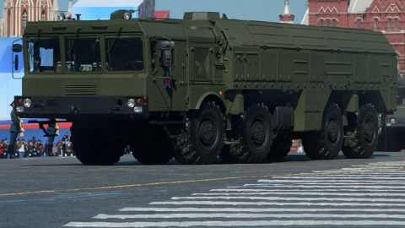
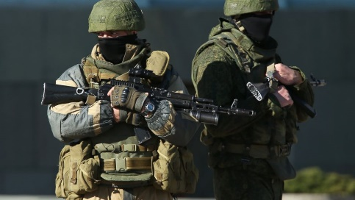
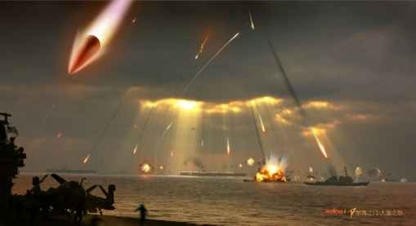
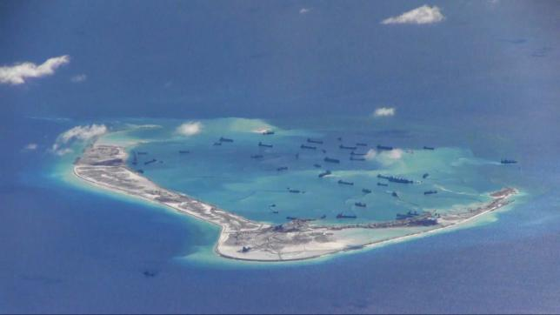

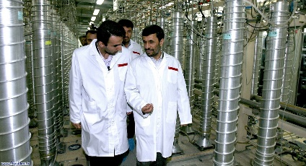
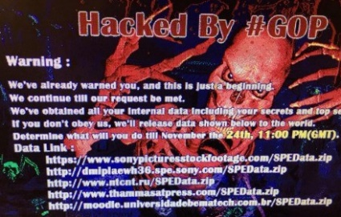
The Gray Zone between Peace and War
Ukraine—Nuclear threats, hybrid war, sanctions, alliance
China—A2/AD, island building, robust trade
Space—C4ISR, ASAT, EW, debris, SSA
Stuxnet—delay a nuclear program, avoid airstrike, civilian infosec firms
Sony—firms, protection, attribution, sanctions

Slide 6
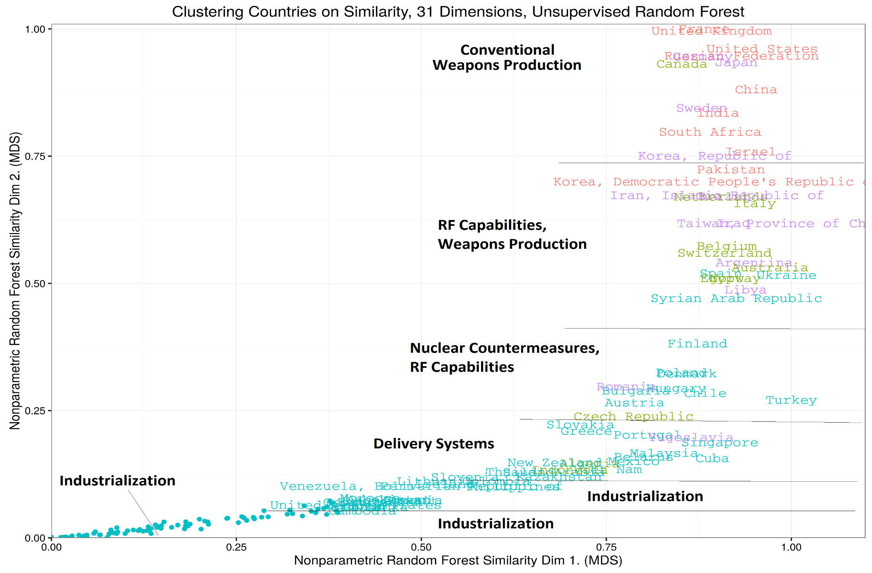
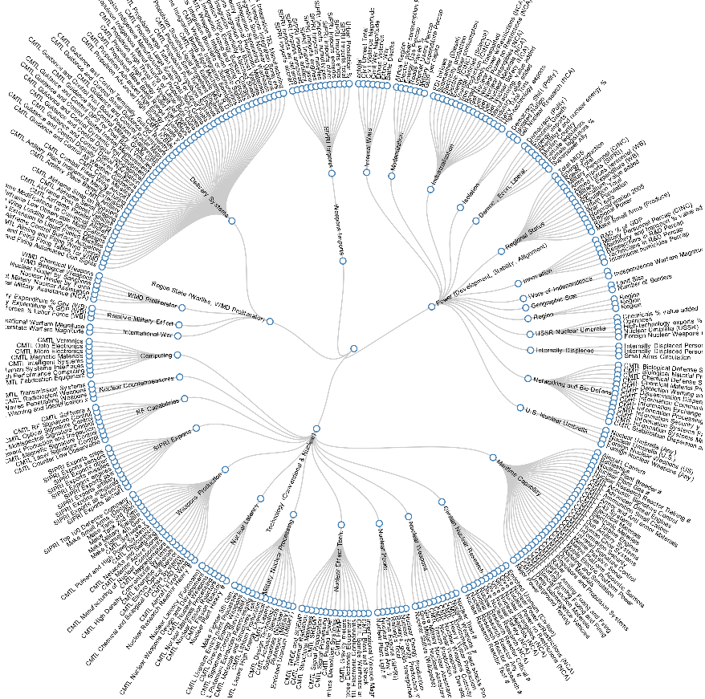
Parsing Complexity
Machine learning identifies 31 latent categories in 319 variables on a cross section of 157 countries

Slide 7
How do Means Matter?
(1) Capabilities, (2) Tradeoffs, (3) Bargaining
Traditionally technology matters for…
  Calculating overall material power
  Offense-defense balance
Power is enhanced via specialization and integration
  Force employment (combined arms, Joint ops, etc.)
  Systems integration
  Public-private interaction
Not all means are available to all players
  Increasing complexity of technology and institutions
  Stronger actors have more options
  Weaker actors limit exposure via asymmetric means

Slide 8
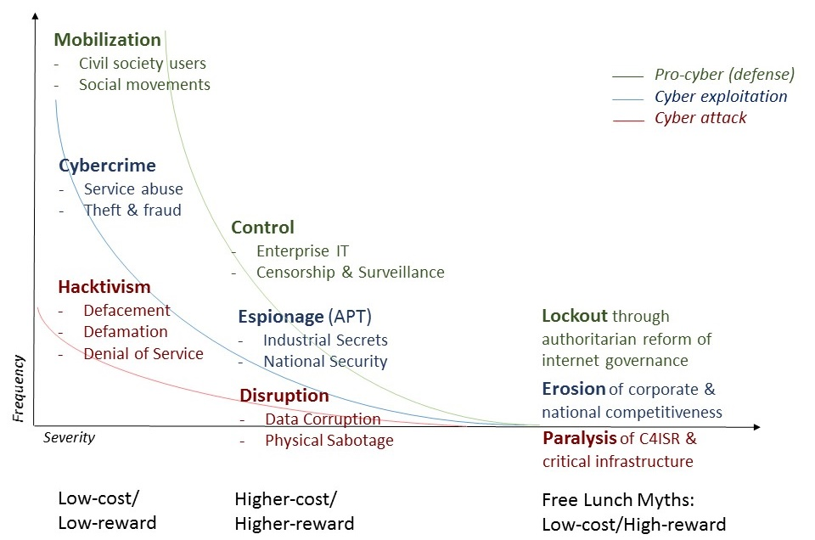
Ex: Cyber

Slide 9
How do Means Matter?
Capabilities, (2) Tradeoffs, (3) Bargaining
Deterrence involves at least two objectives
  Minimize conflict (signaling problem)
  Maximize benefit (distributional problem)
Different military capabilities support them differently
  Clear and credible commitments can reduce uncertainty
  Stealthy and/or mobile forces can tip the balance of power
  Intelligence reduces uncertainty…for only one side
  Factors increasing victory in war can actually increase uncertainty in peace – causing suboptimal deterrence

Slide 10
Ex: Seapower
Navies enhance mobility, firepower, & presence, but create political tradeoffs
  Improve power projection—disputes occur further from home
  Augment influence—increased diplomatic recognition
  Increased uncertainty—greater onset of militarized disputes
Naval platforms exhibit differences
  Aircraft carriers improve influence and increase uncertainty
  Submarines enhance power projection and increase uncertainty
  Battleships have no apparent disproportionate effects
Tonnage→
MIDs
Platforms→
MIDs

Slide 11
How do Means Matter?
Capabilities, (2) Tradeoffs, (3) Bargaining
Opponents can respond similarly or differently
  Comparative advantage or costly signaling of resolve?
  Clear or ambiguous signals?
Combinations of means can change attributes
  Complements or substitutes?
    Ex: nuclear stability ← ? → cyber instability
  One game or linkage to others?
Temporal sequencing
  Longer sequences of moves become possible
  Escalation/de-escalation becomes path-dependent
  Renegotiation become more likely

Slide 12
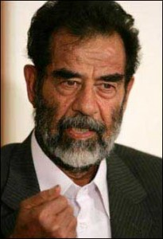




Ex: Chicken vs. RPS
Asymmetry
Interdependence
Stakes?
Repetition?
New moves?
Foreknowledge?
rock
sticks and carrots
paper
cyberwar?
scissors
Notes:
Schelling had Chicken, we have RPS

Slide 13
Conceptual Framework
Complexity
Uncertainty
change the balance of power (Winning)
Actors have a portfolio of bargaining moves to…
revise or reinforce the status quo
Political uncertainty:
signal interests & resolve (Warning)
Power
Costs
Demands
Outcomes
Resolve
Change
Increasing political complexity
New means for winning and warning
New linkages and interdependence
New bargaining relationships
Strategy
Operations
Military uncertainty:
Militaries pursue new means for winning
Capabilities
Disposition
Infrastructure
Organization
Doctrine & plans
Logistics & C4ISR
Increasing military complexity
New complements
New substitutes
New combinations
Arms race
Lethality
Protection
Force employment
Specialization
Coordination

Slide 14
Deterrence in the gray zone
Deterrence “failure” is relative
  Gray zone threats only exist because deterrence works against truly dangerous threats—reinforce success
  Not every game is worth the candle—tolerate some friction
  There are multiple games in play—understand the tradeoffs
  Containment is a long game
Deception and intelligence becomes vital
  Deception is democratizing—private targets and players
  Deception does not scale—ambitious attacks are self-limiting
  Deception can be used for defense too—need policy for hack back
  Let the other side move first—reduce ambiguity
  Be able to let the other side go first—improve & advertise resilience
Protect comparative advantages
  Complexity management—personnel & institutions
  Industrial performance—backlash from Snowden
  Defense in depth—command of the commons & economic power

Slide 15
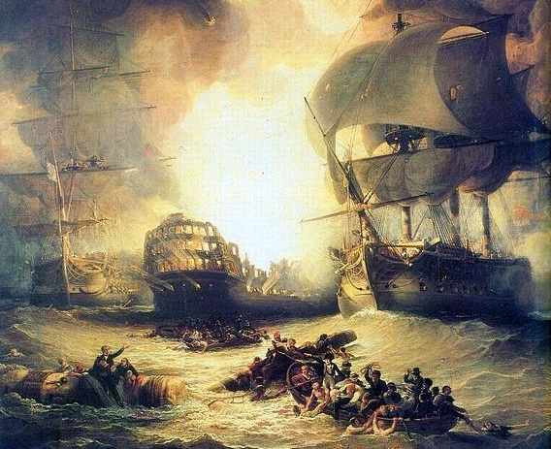
Questions?

Slide 16
Project Organization
Program Management
$5M, 5yr (2014-18)
DOD Minerva
ONR
UCSD
Erik Gartzke (PI)
Rex Douglas
Grad Students
Jason Lopez (Administrator)
LLNL
Benjamin Bahney
Peter Barnes
Celeste Mattarazo
Postdoc TBA
LANL
Joseph Pilat
UC Berkeley
Michael Nacht
Grad Students
U Toronto
Jon Lindsay (PI)
Grad Students
Data subaward
U Maryland
Jonathan Wilkenfeld
Duke
Kyle Beardsley
Modeling
Policy Expertise
Case Studies
Data Analysis

Slide 17
Project Schedule
Add on option
 | 2014 | 2015 | 2016 | 2017 | 2018
Exploration & outreach
Theory building & case study
Computational modeling
Empirical data analysis
Workshops (major conferences)
Administration
Consultation with policymakers and experts
Capstone conference
CDD ed. volume
CDDI revisited
Lit reviews
Cyber & WMD research
Information technology book
Grand strategy book
Formal modeling
LLNL postdoc search
Iterative modeling
HPC runs
Naval power projection
Coding, Curating,
Analysis, Testing,
Synthesis w/ theory & modeling
ICB expansion
Military Basing
Mil Specialties
CDD BOP & Activity
IGCC
UCSD Political Science

Slide 18
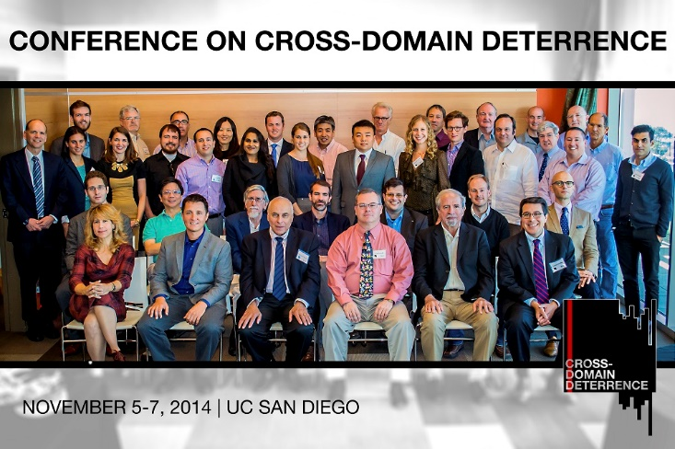
CDD Conference

Slide 19
Peer-Reviewed Publications
Journal articles
  Brenner, Joel, and Jon R. Lindsay. “Correspondence: Debating the Chinese Cyber Threat.” International Security (Forthcoming 2015)
  Gartzke, Erik, and Jon R. Lindsay. “Weaving Tangled Webs: Offense, Defense, and Deception in Cyberspace.” Security Studies, Forthcoming 2015.
  Haggard, Stephan, and Jon R. Lindsay. “North Korea and the Sony Hack: Exporting Instability Through Cyberspace.” East-West Center AsiaPacific Issues, no. 117 (May 2015).
  Lindsay, Jon R. “The Impact of China on Cybersecurity: Fiction and Friction.” International Security 39, no. 3 (Winter 2014): 7–47.
  Lindsay, Jon R., and Lucas Kello. “Correspondence: A Cyber Disagreement.” International Security 39, no. 2 (October 1, 2014): 181–92.
  Gartzke, Erik. “An Apology for Numbers in the Study of National Security...if an apology is really necessary,” H-Diplo/ISSF, No. 2 (2014): 77-90. URL: http://issforum.org/ISSF/PDF/ISSF-Forum-2.pdf
  Gartzke, Erik. “The Myth of Cyberwar: Bringing War in Cyberspace Back Down to Earth.” International Security 38, no. 2 (2013): 41–73.
  Lindsay, Jon R. “Stuxnet and the Limits of Cyber Warfare.” Security Studies 22, no. 3 (2013): 365–404.
Under review
  Gartzke, Erik. "No Humans Were Harmed in the Making of this War: On the Nature and Consequences of `Costless’ Combat”
  Gartzke, Erik and Koji Kagotani. "Trust in Tripwires: Deployments, Costly Signaling and Extended General Deterrence.”
  Gartzke, Erik and Oliver Westerwinter, “The Complex Structure of Commercial Peace: Contrasting Trade Interdependence, Asymmetry and Multipolarity”
  Lindsay, Jon R. “The Attribution Problem and the Stability of Deterrence.”
  Lindsay, Jon R., and Erik Gartzke. “Coercion through Cyberspace: The Stability-Instability Paradox Revisited.” In The Power to Hurt, edited by Kelly M. Greenhill and Peter J. P. Krause.
  Lindsay, Jon R. and Jiakun Jack Zhang. “The Commercial Peace in Space and Cyberspace: Cautious Optimism about US-China Relations.”

Slide 20
Other Publications
Policy Papers
  Lindsay, Jon R. “Exaggerating the Chinese Cyber Threat.” Policy Brief, Belfer Center for Science and International Affairs, Harvard Kennedy School, May 2015. http://belfercenter.ksg.harvard.edu/publication/25321/exaggerating_the_chinese_cyber_threat.html
  Lindsay, Jon R., Tai Ming Cheung, and Derek S. Reveron. “Will China and America Clash in Cyberspace?” The National Interest, April 12, 2015, http://nationalinterest.org/feature/will-china-america-clash-cyberspace-12607
  Gartzke, Erik. "Making Sense of Cyberwar." Policy Brief, Belfer Center for Science and International Affairs, Harvard Kennedy School, January 2014, http://belfercenter.hks.harvard.edu/publication/23796/making_sense_of_cyberwar.html
  Gartzke, Erik. "Fear and War in Cyberspace." Lawfare, December 1, 2013, http://www.lawfareblog.com/2013/12/foreign-policy-essay-erik-gartzke-on-fear-and-war-in-cyberspace/
Working Papers
  Carcelli, Shannon. “Deterrence Literature Review”
  Gartzke, Erik. "Drafting Disputes: Military Labor, Regime Type and Interstate Conflict.”
  Gartzke, Erik. "Nukes in Cyberspace: Potential Pitfalls of Cyberwar in a Thermonuclear World.“
  Gartzke, Erik. "The Influence of Seapower on Politics: Domain and Platform Specific Attributes of Material Capabilities.”
  Gartzke, Erik and Koji Kagotani. "Being There: U.S. Troop Deployments, Force Posture and Alliance Reliability.”
  Gartzke, Erik and Jon R. Lindsay. “Cybersecurity and Cross Domain Deterrence”
  Gartzke, Erik and Jon R. Lindsay. “Windows on Submarines: Cyber Vulnerabilities and Opportunities in the Maritime Domain”
  Kaplow, Jeffrey M. and Erik Gartzke. “Knowing Unknowns: The Effect of Uncertainty on Interstate Conflict.”
  Kaplow, Jeffrey M. and Erik Gartzke. “The Determinants of Uncertainty in International Relations.”
  Lindsay, Jon R. “Proxy Wars: The Common Strategic Logic of Cybersecurity and Counterinsurgency”
  Qiu, Mingda. “Chinese Thinking about Deterrence, Space, and Cyberspace in the 2013 Science of Military Strategy”

Slide 21
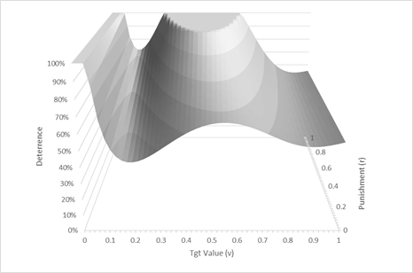
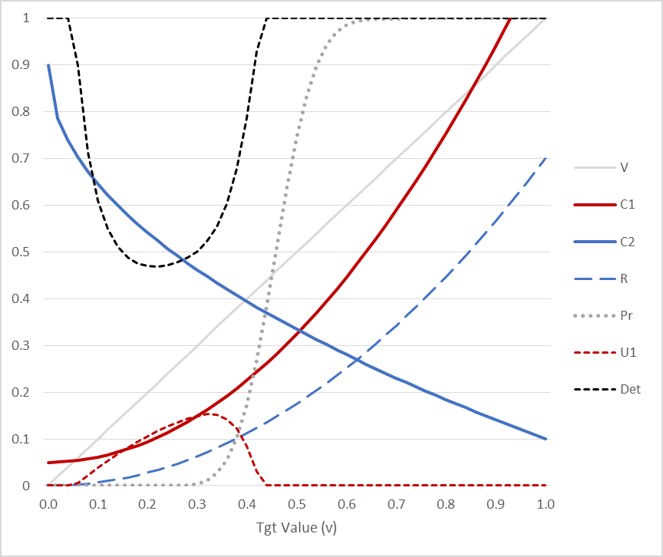
Cyber research
Cyberspace is prominent as an (if not the) emerging domain motivating CDD policy concerns because it connects and controls activity in all other domains
Publications on…
  Strategy
  Coercion*
  Deception
  Attribution*
  Stuxnet
  China
  Sony Hack
  Space-Cyber*
  Maritime-Cyber*
  Nuclear-Cyber*
  CDD-Cyber*
  COIN-Cyber*
  *under review or in progress

Slide 22
Testing CDD with ICB
The International Crisis Behavior Dataset, maintained by U Maryland CIDCM, contains information on 455 international crises, 35 protracted conflicts, and 1000 crisis actors from the end of World War I through 2007.
  We will expand cases up to 2013 and add variables to track domains of crisis triggers and responses
  Do responses out of domain, or action in multiple domains, or access to more domains, etc., make a difference in crisis outcomes?
  How does the sequencing of moves matter?
Meeting at Duke in July 2015 to plan research and coding
Magnitude/ Modality | Land | Air | Maritime | Space | Information
WMD: CBRN+ | ICBM/MRBM,Mass casualty terrorism | Bomber, ALCM, HEMP | SSBN, SLCM | HAND, ASAT on NUDET/EW | Critical infrastructure destruction
Conventional: military ops, use-of-force | Combined arms ops, invasion, occupation, defense | Strategic and tactical air forces | Sea control, power proj, commerce raiding, blockade | BMD, ASAT, Co-orbital interference, Destructive directed energy | Elec. warfare, cyber-physical disruption
Nonconventional: clandestine ops, intelligence, MOOTW | SOF (CT, CP, FID, UW, CA), proxies, paramilitaries, base constr. | Surveillance, drones | Coast Guard, FON, presence, surveillance, base constr. | ISR, MILCOM, non-destructive jamming | Espionage (CNE), hacktivism, MILDEC
Nonmilitary: political, economic, social actions | Development assistance, terraforming, migration & refugees, exploration | Civilian airlift, transport | Civilian sealift, land reclaim, boat migrants, exploration | Civilian PNT, remote sensing, science, HSF, communications | treaties, sanctions, propaganda, messaging, demarches

Slide 23
Empirical Research
Cyber and space motivate CDD research, but actors have practiced CDD for centuries—historical empirical research is feasible!
  $230k plus up from Minerva to expand and accelerate empirical research (originally planned for year 4)
  Funding for colleagues at U Maryland and Duke
  Hiring new full time Project Scientist at UCSD to spearhead data curation and analysis
New empirical data projects
  Adding CDD variables to the ICB (next slide)
  The influence of naval power on politics
  The military and naval division of labor as a measure of increasing complexity
  Cross-national indicators of cross-domain capacity and activity
  Quantifying uncertainty in IR
  Military basing as a measure of CDD and power projection capacity
  CDD correlates of events behavior

Slide 24
Computational Modeling
Approaches to Modeling CDD
  Situate in the language of game theory
  Catalog the actors, realms, actions and payoffs
  Careful meta-analysis to identify fundamentally distinct objects
  Expect complexity
LLNL search for a modeling postdoc
  Few candidates have expertise in IR and modeling—expanding aperture for any interested agent- or discrete event-modelers.
  LLNL postdoc will work closely with UCSD data scientist to harmonize modeling and empirical efforts

Slide 25
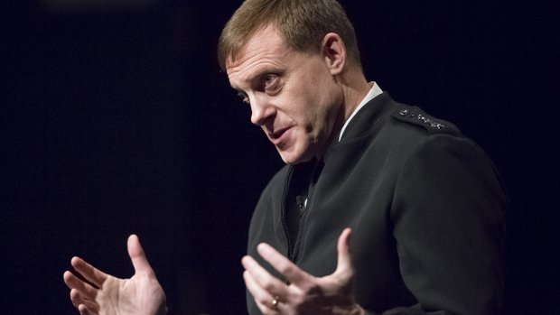
Policy outreach
Briefings
  DIRNSA/USCC ADM Michael Rogers
  Under Secretary of the Army Brad Carson
  OSD-Policy staff
  US Naval War College
  National Air and Space Intelligence Center
  Naval Postgraduate School
  California Maritime Academy
  Canadian Security Intelligence Service
  18th MIT Senior Congressional and Executive Office Branch Seminar
Policy history of CDD (Michael Nacht)
  What is the origin of the term CDD?
  How has the concept evolved and been used in the USG?
CDDI Revisited
  The DOD ASD-GSA conducted the 21st Century Cross Domain Deterrence Initiative (CDDI) in March/April 2010, asking 11 scholars and analysts from outside DOD to reflect on the contemporary relevance of classical strategy.
  We have submitted a FOIA for all information and reporting from this event
  We are considering reconvening this group in year 5 to assess their recommendations in light of national security affairs in the past decade and to react to current research on CDD.
Year 5 Policy Capstone conference in DC

Slide 26
Graduate Student Training
Grad students (& placement)
  Rupal Mehta—U of Nebraska, Lincoln
  Jeff Kaplow—College of William and Mary
  Blake McMahon—Air War College
  Shannon Carcelli
  Clara Suong
  Jiakun Jack Zhang
  Hye Jung
  Kelly Matush
  Mingda Qiu
  Patrick Davis
  Paul Spitzen
  Patricia Schuster
  Eva Uribe
Courses adapted or designed for CDD
  Intro to Strategic Studies
  (UCSD IRPS 2014, 2015)
  Grand Strategy and Defense Policy
  (UCSD IRPS 2014, 2015)
  The Future of Cyberspace and the Future of War
  (U of Toronto 2016)
  The Impact of Technology on Grand Strategy
  (U of Toronto 2016)

